Slide 1

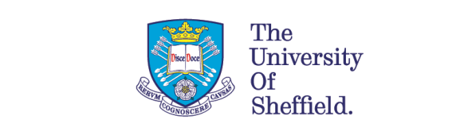
grantham.sheffield.ac.uk
@granthamcsf

Slide 2
Camp Wisdom
Anthony J Ryan OBE
Professor of Physical Chemistry
Director of the Grantham Centre

Slide 3

The Age of Consequences

Slide 4
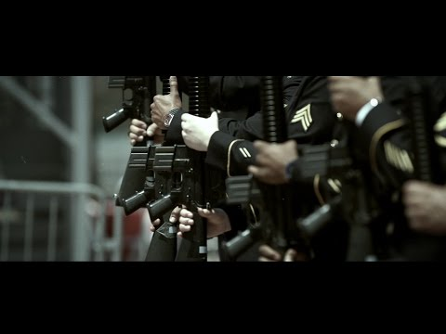

Slide 5

Mass migration driven by conflicts
Conflicts sparked by climate change

Slide 6
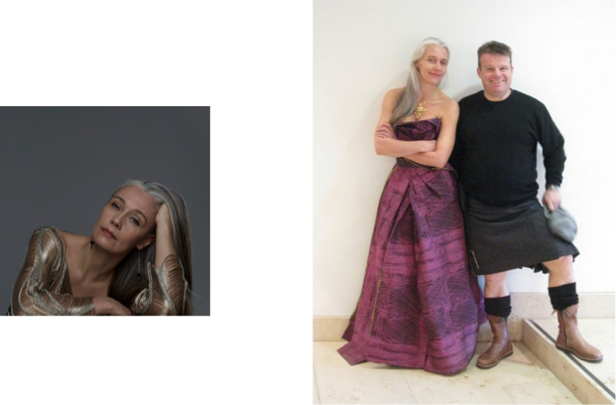
Professor
Helen Storey MBE

Slide 7
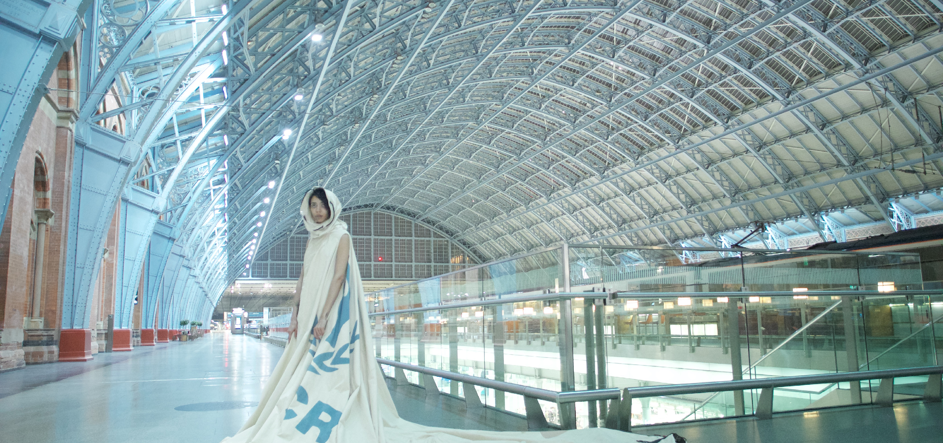
A Dress for Our Time

Slide 8
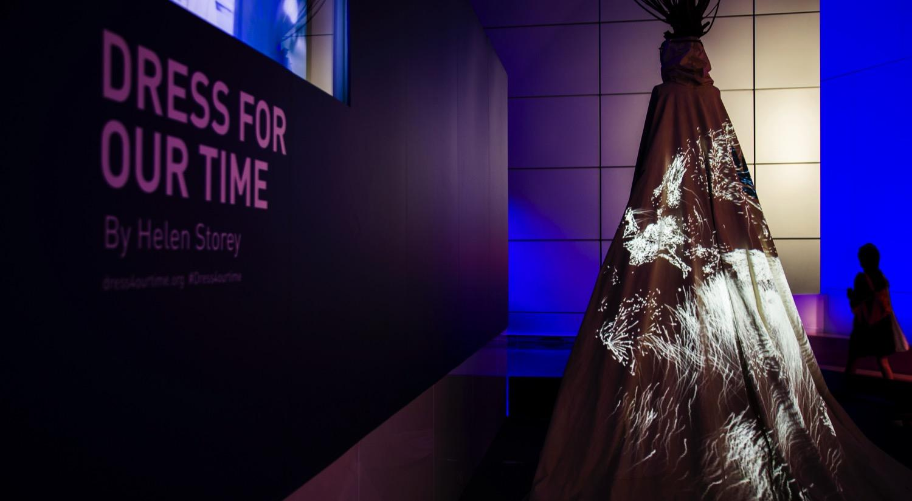

Slide 9
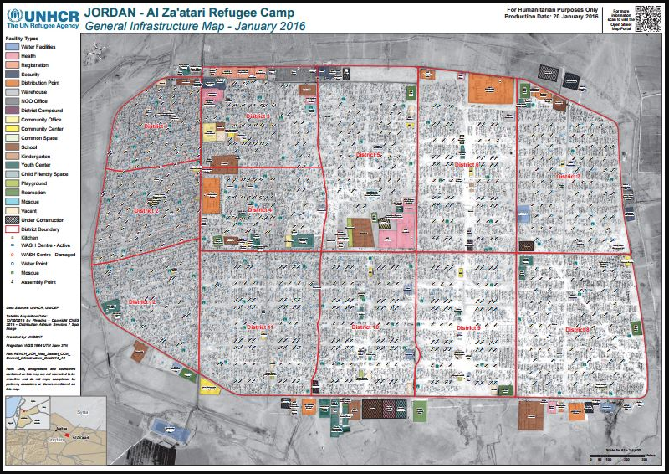
1st Zaatari Visit – July 2016

Slide 10

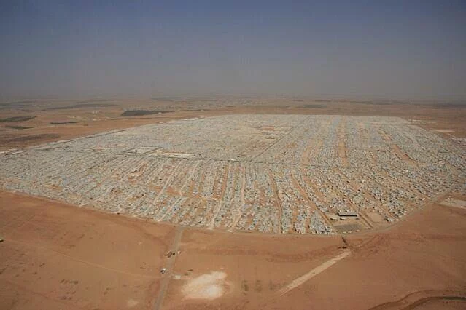
Za’atari
Home to
80,000
people

Slide 11
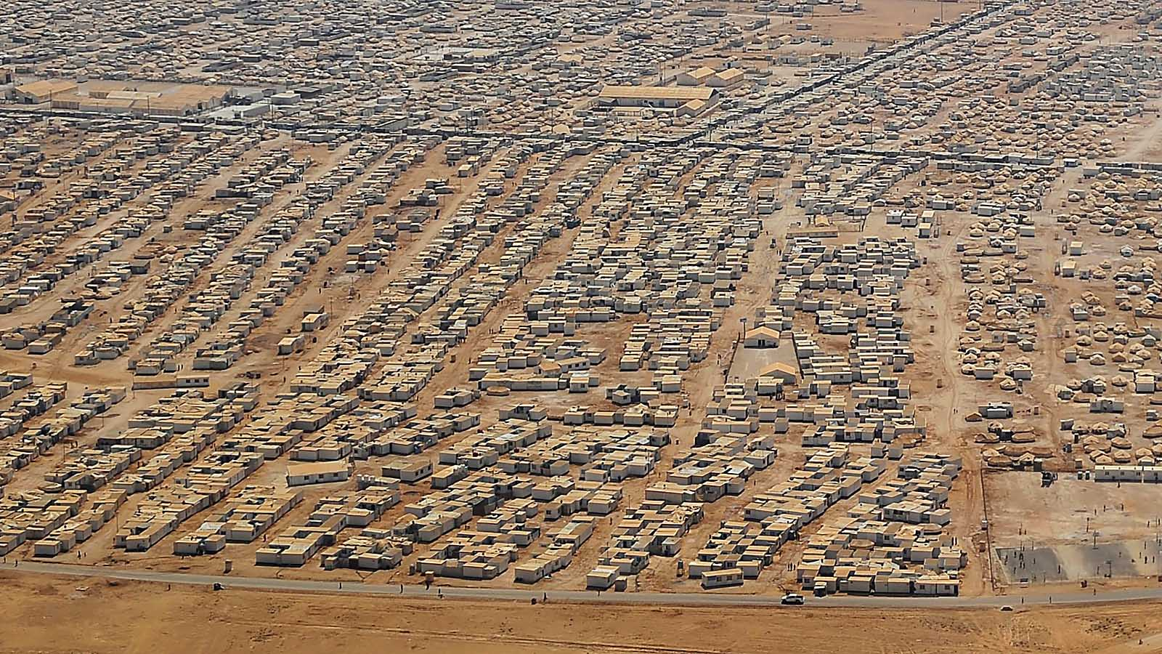

Slide 12


Slide 13
Status of the camp
It is a temporary camp!
The refugees want to go home
Illegal immigrants, can’t work
The host community want them to go to
Nothing that’s “permanent” is permitted
Bricolage

Slide 14
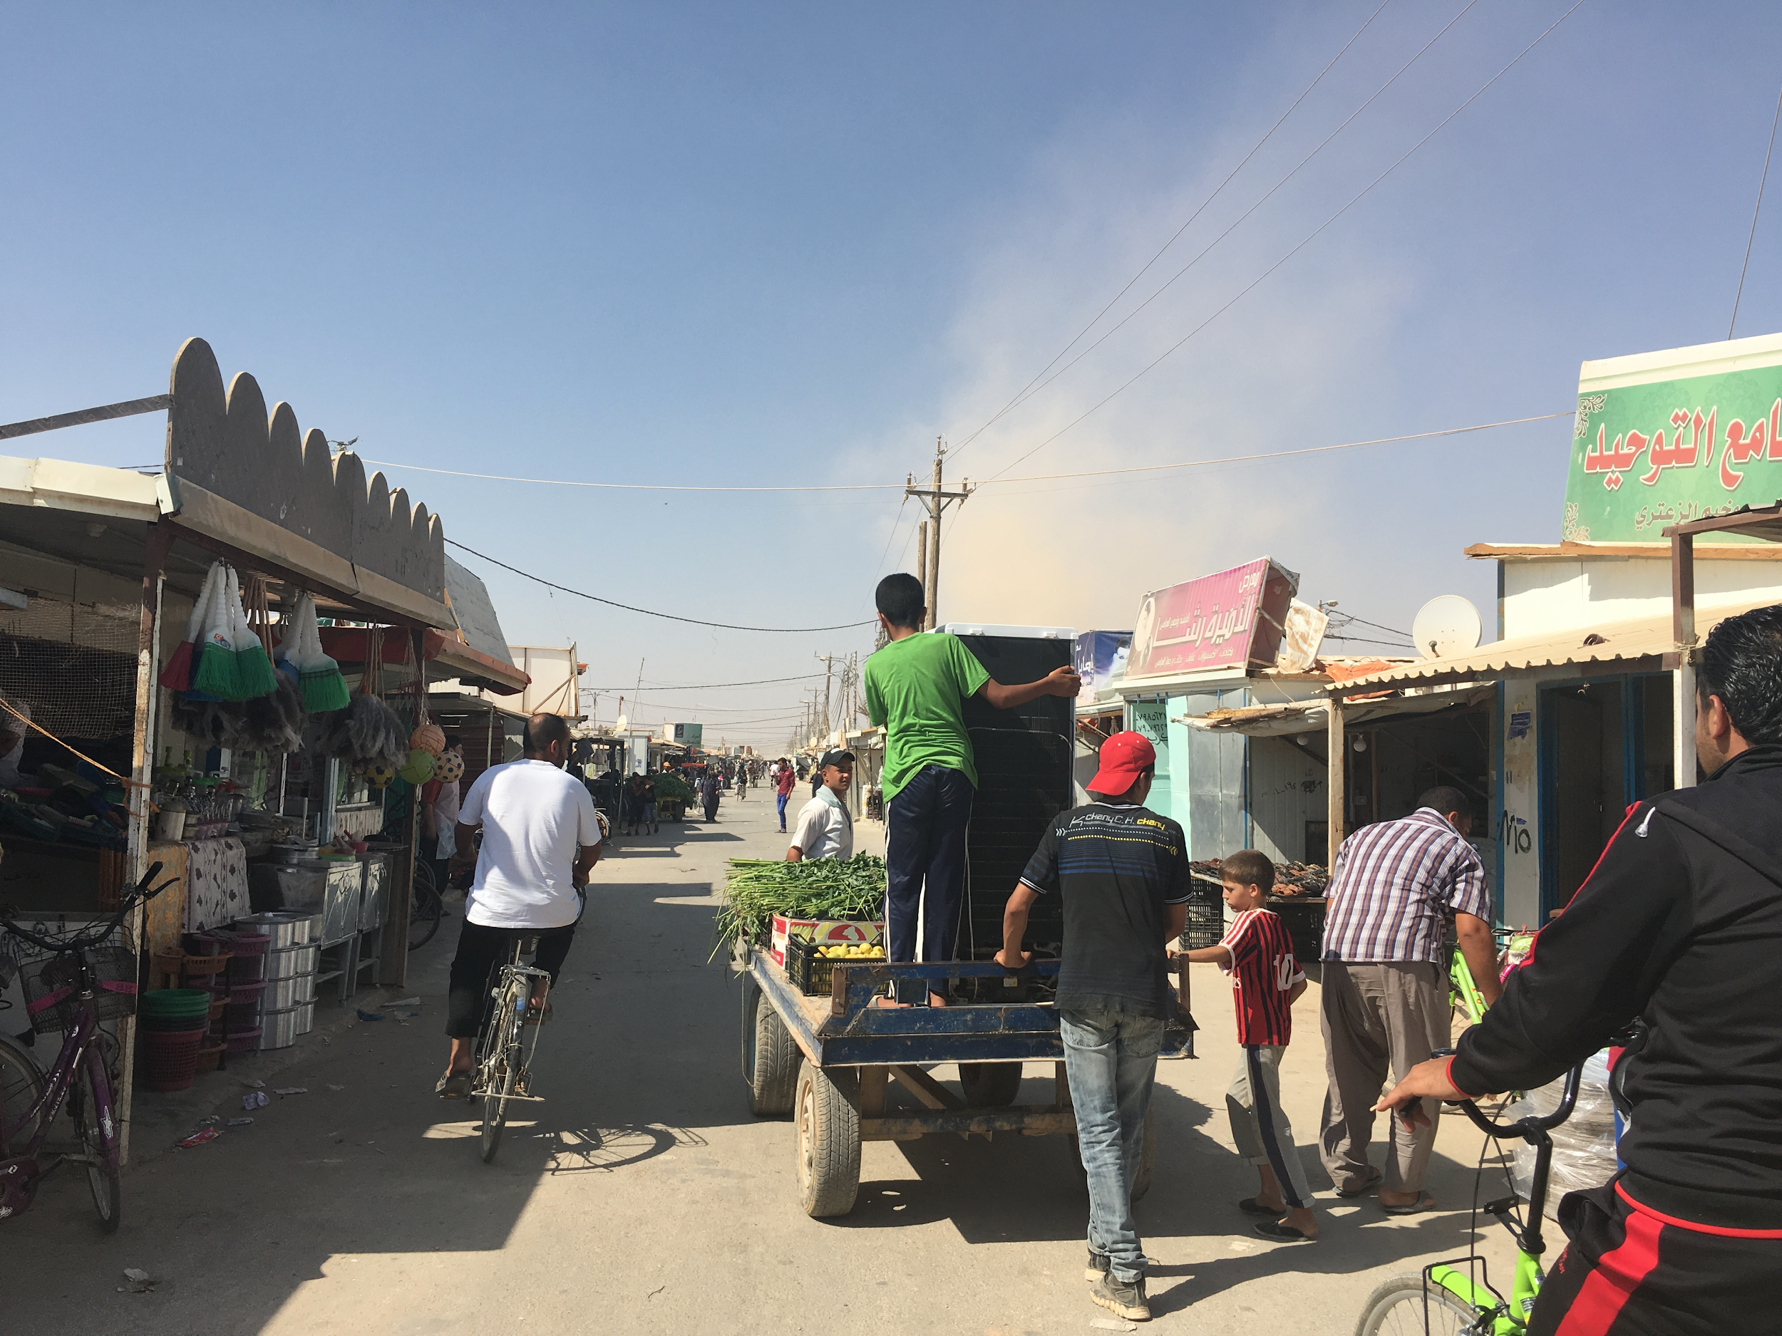
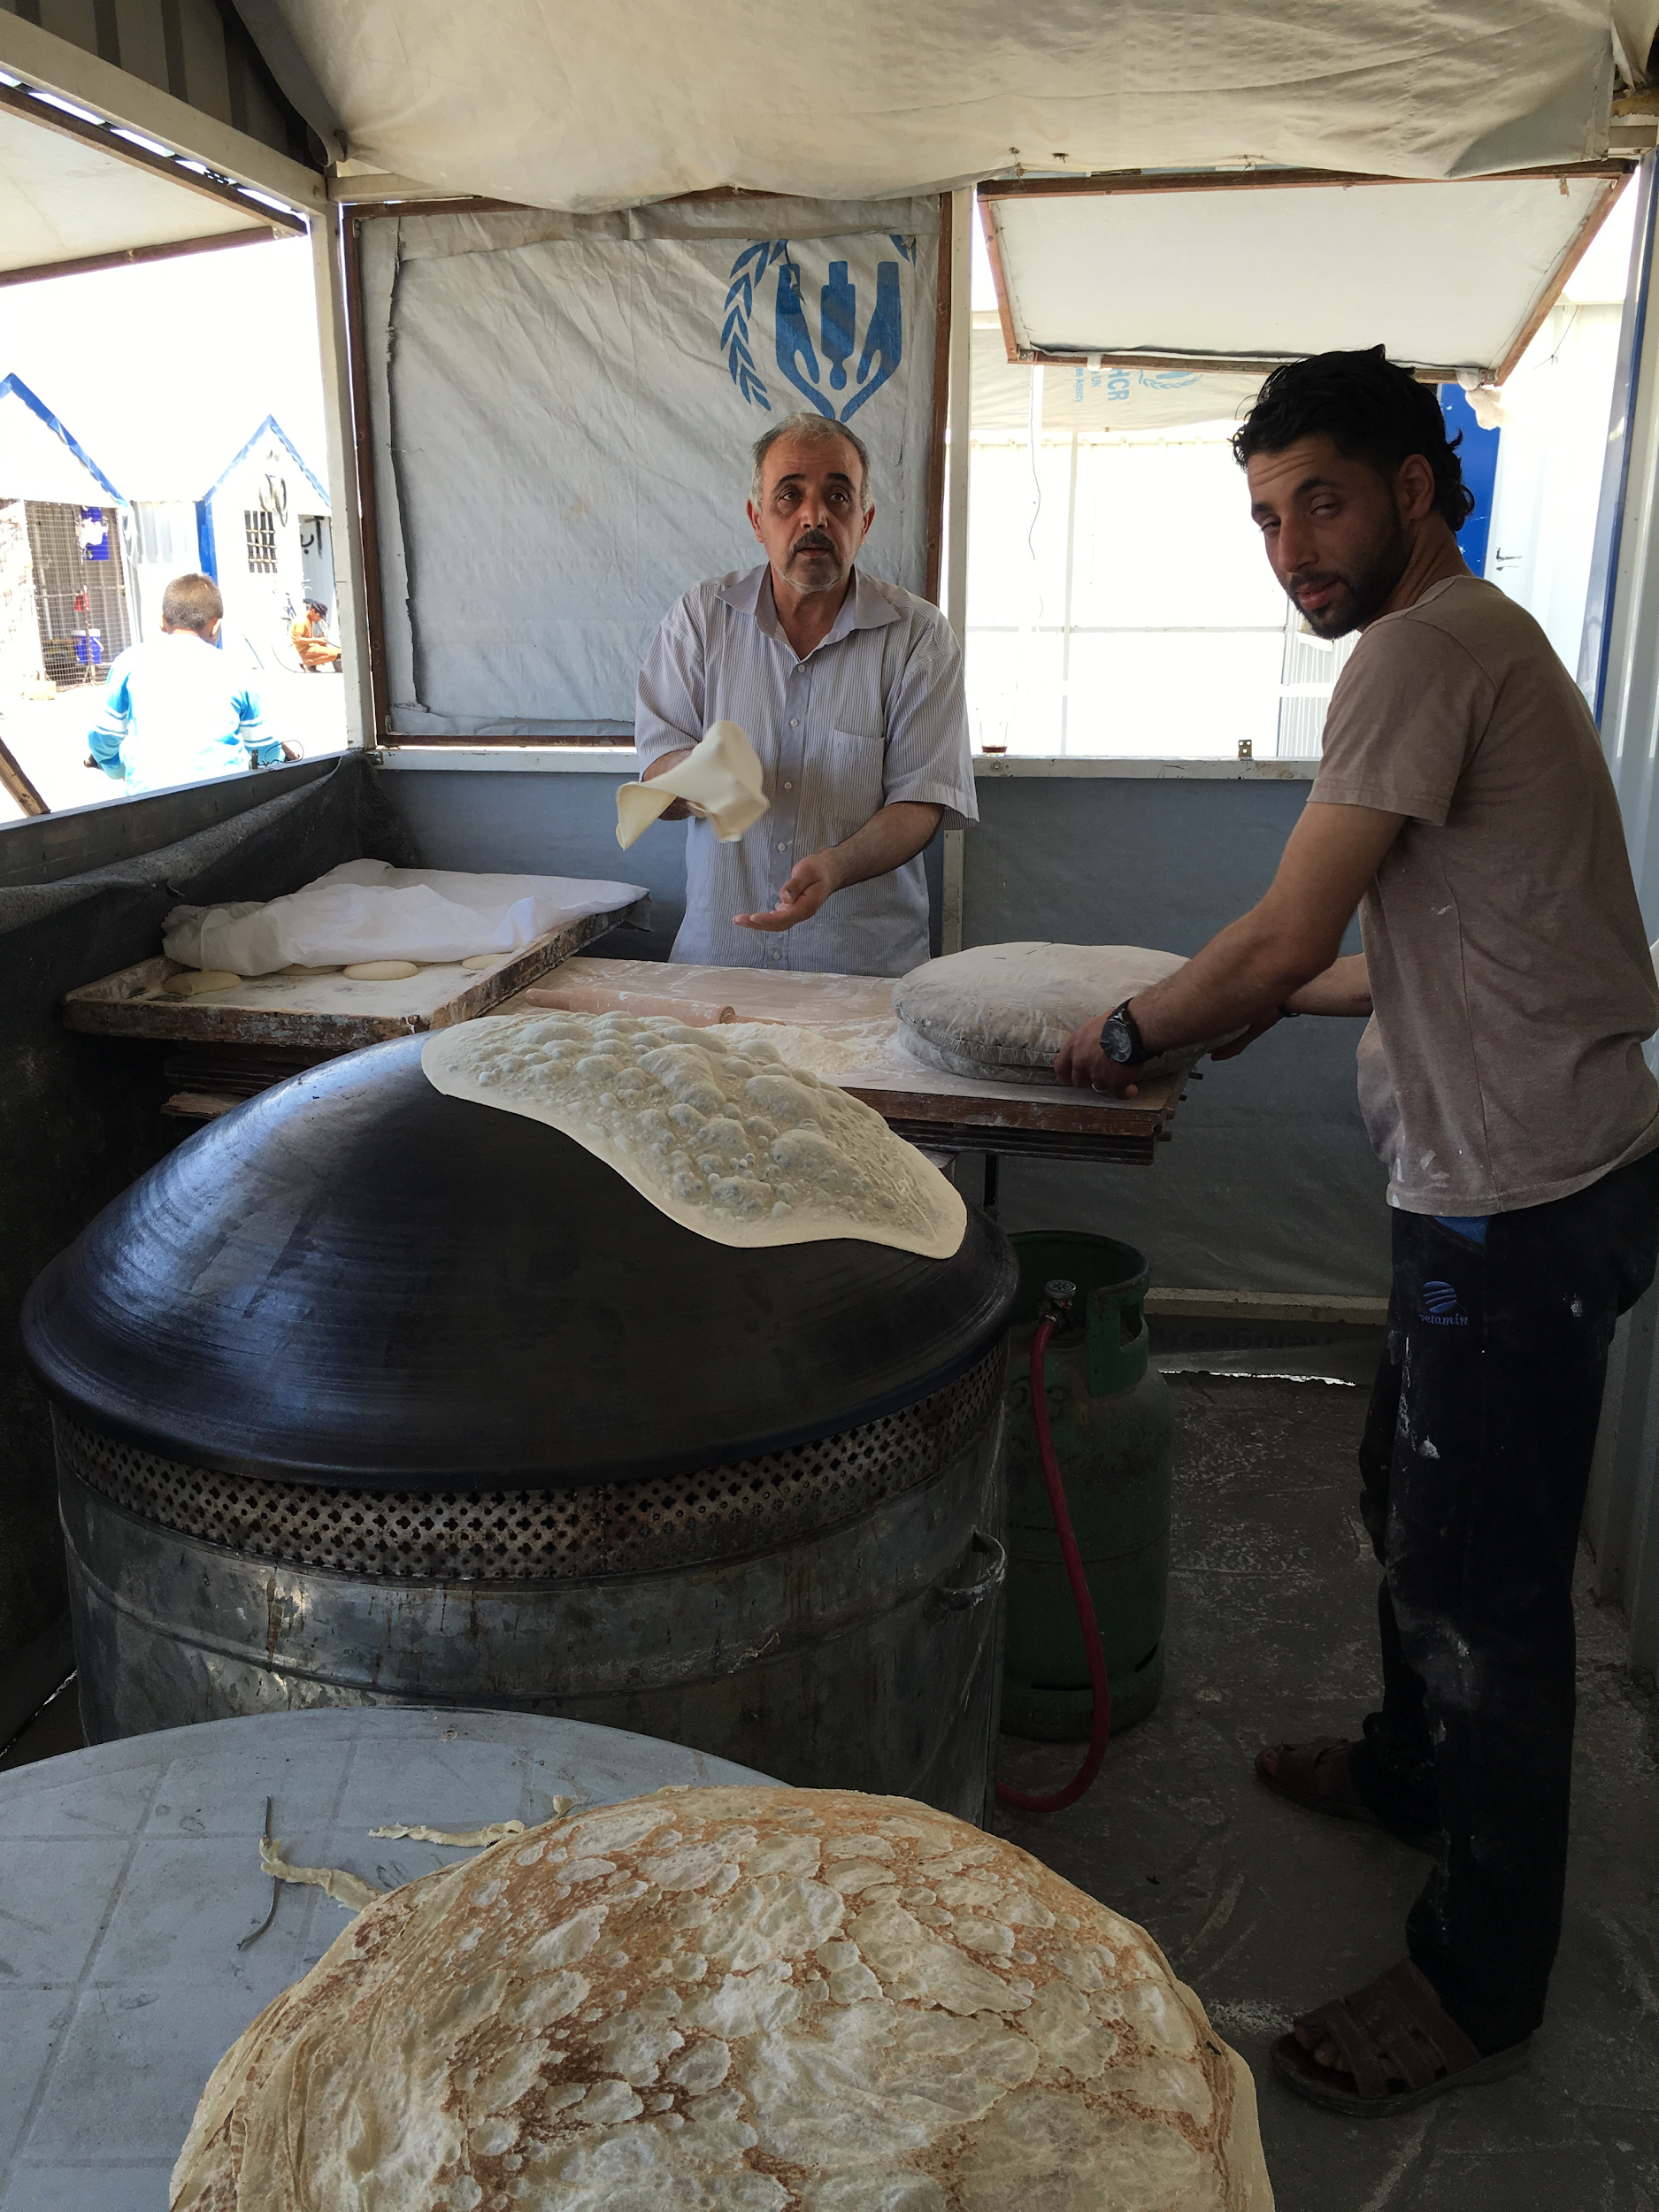
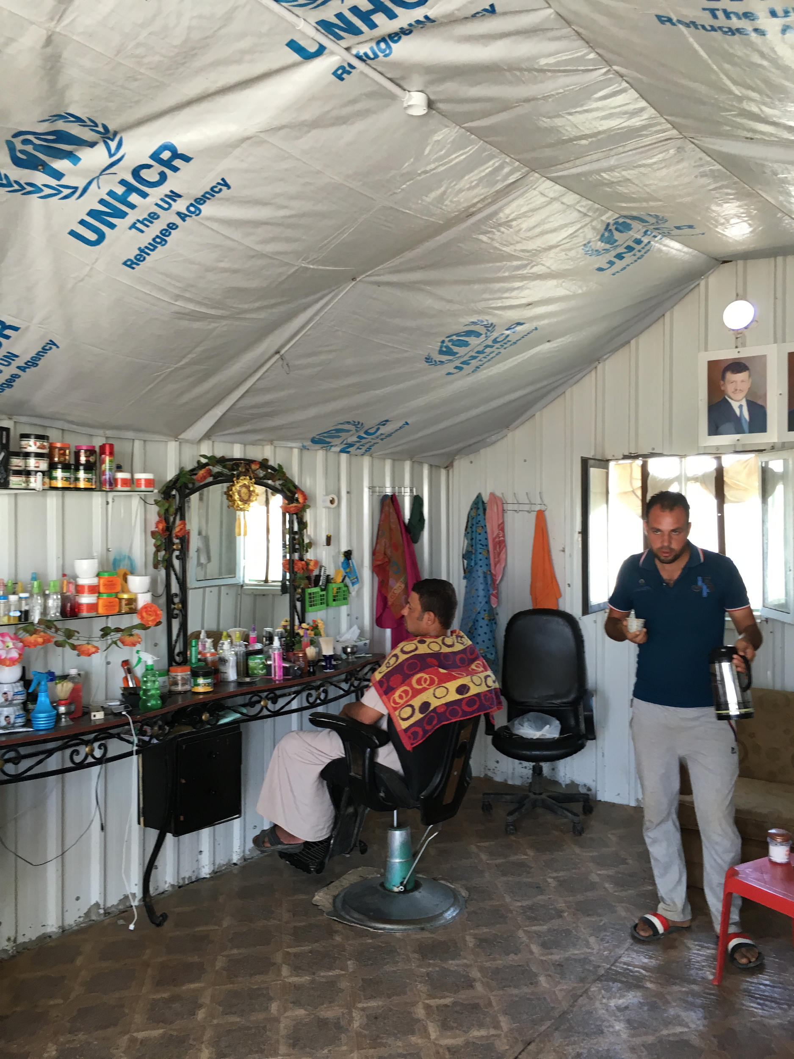

Slide 15
We went back in January
Build an “ideal home”
Test out some new technologies
See how our experiments have been taken up and improved on.

Slide 16
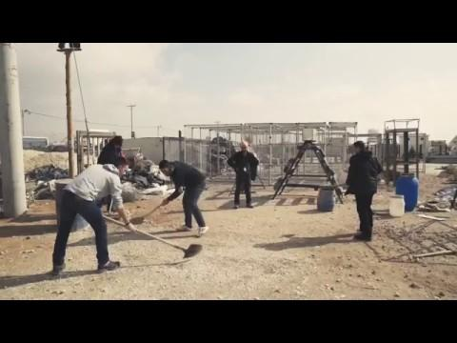

Slide 17
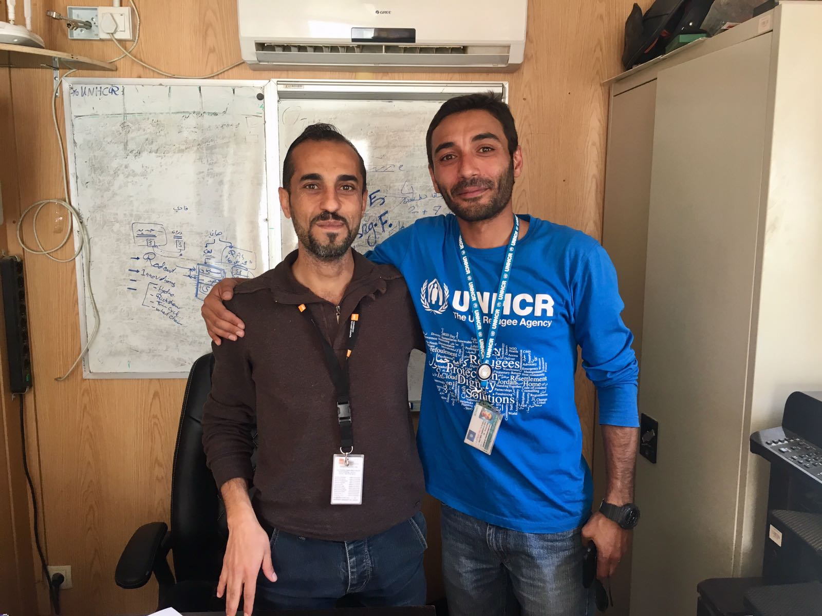

Slide 18
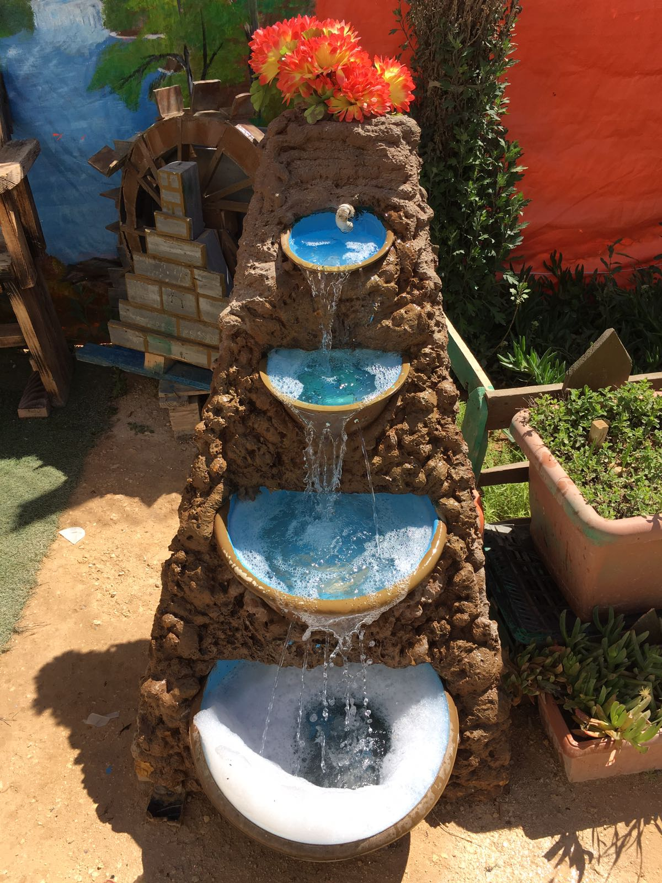
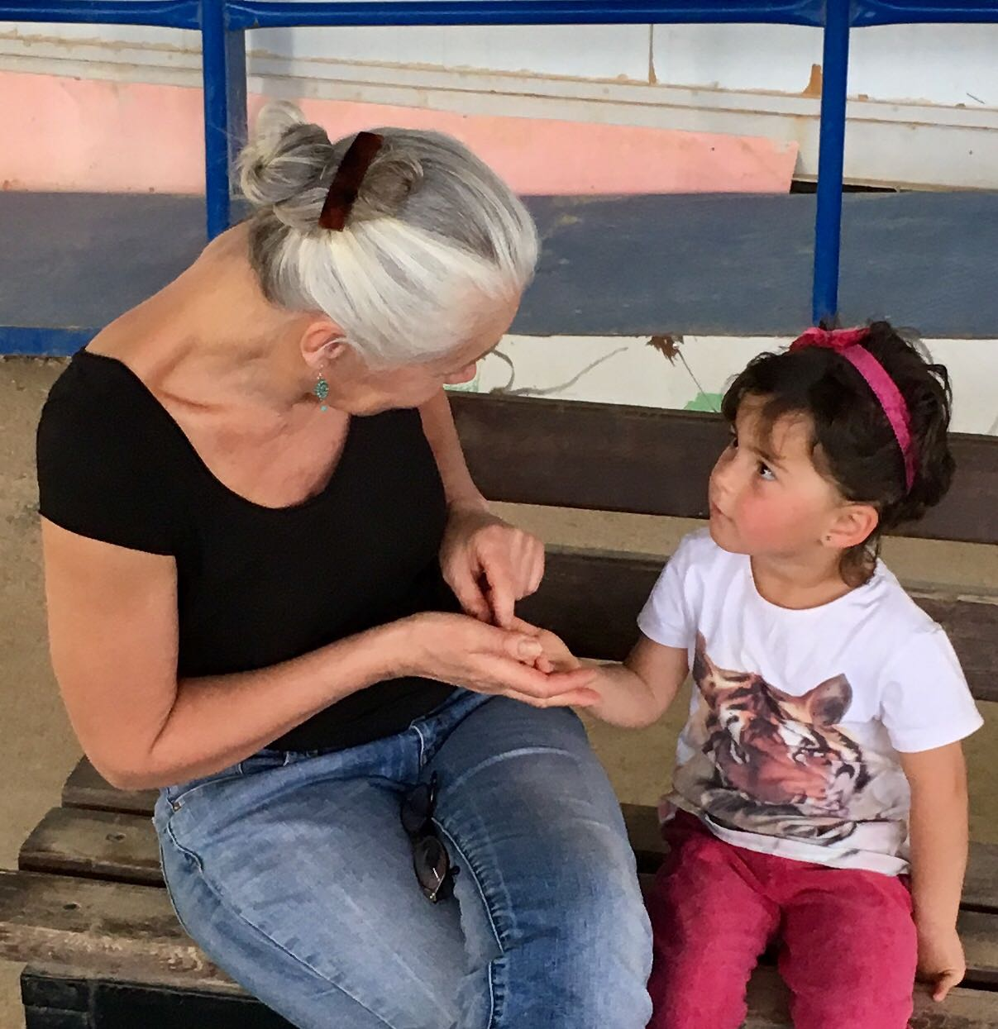

Slide 19
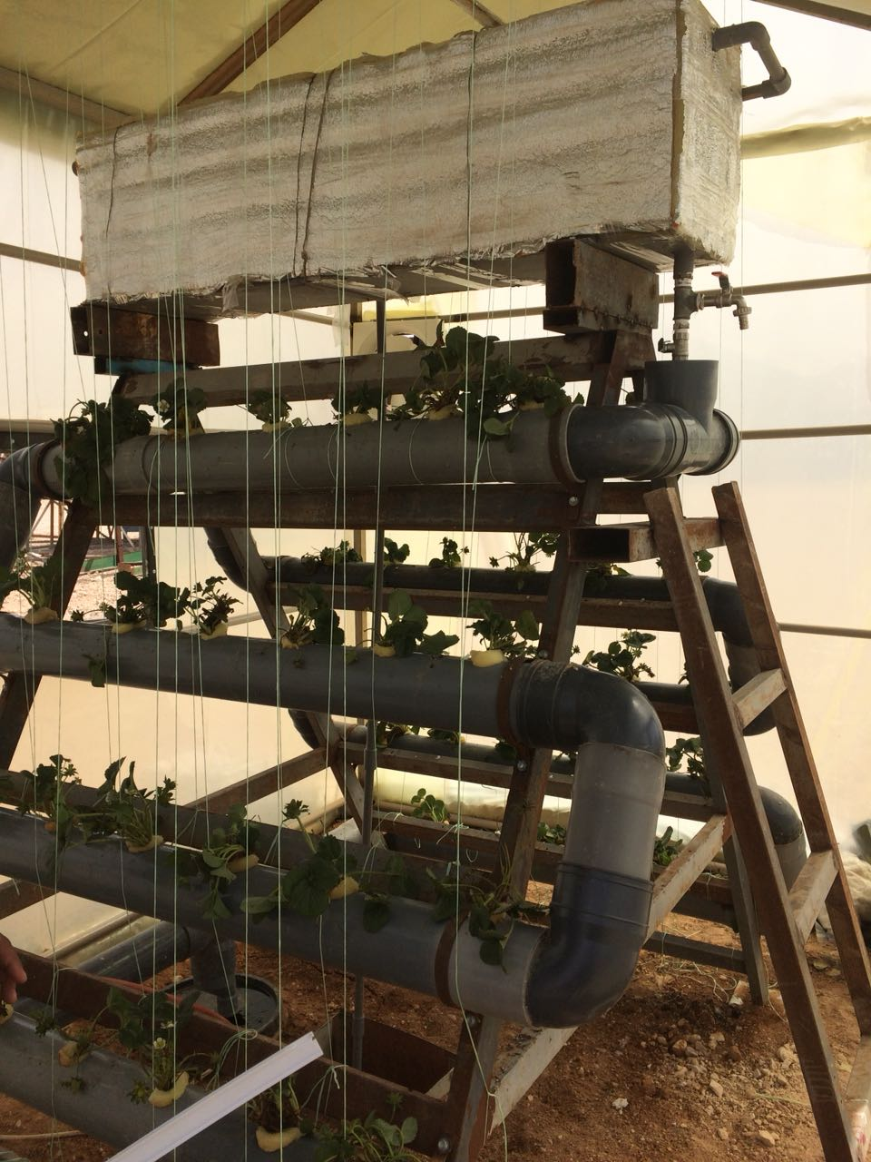
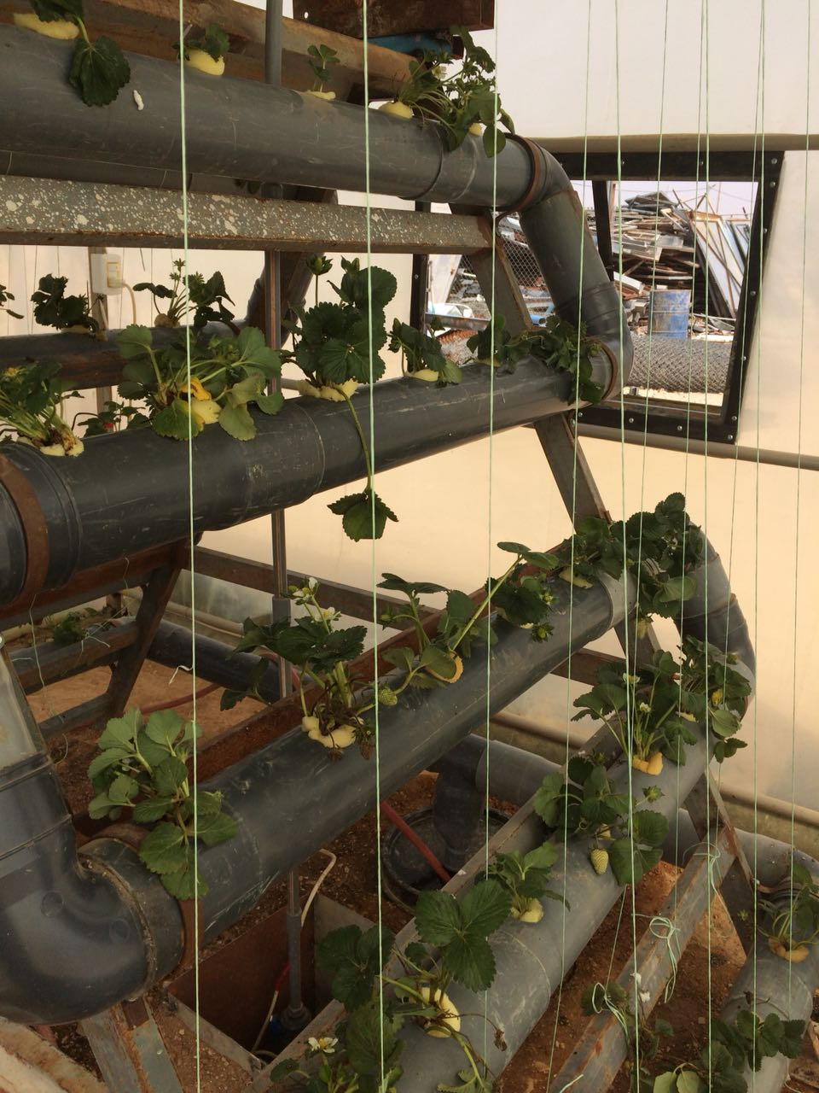
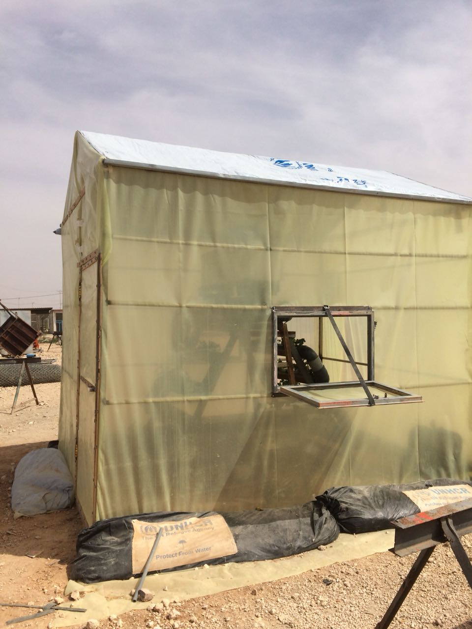

Slide 20
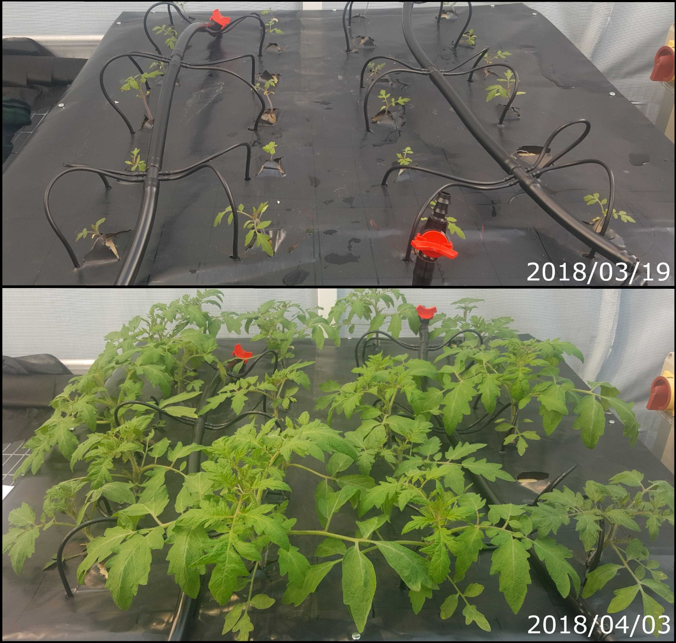
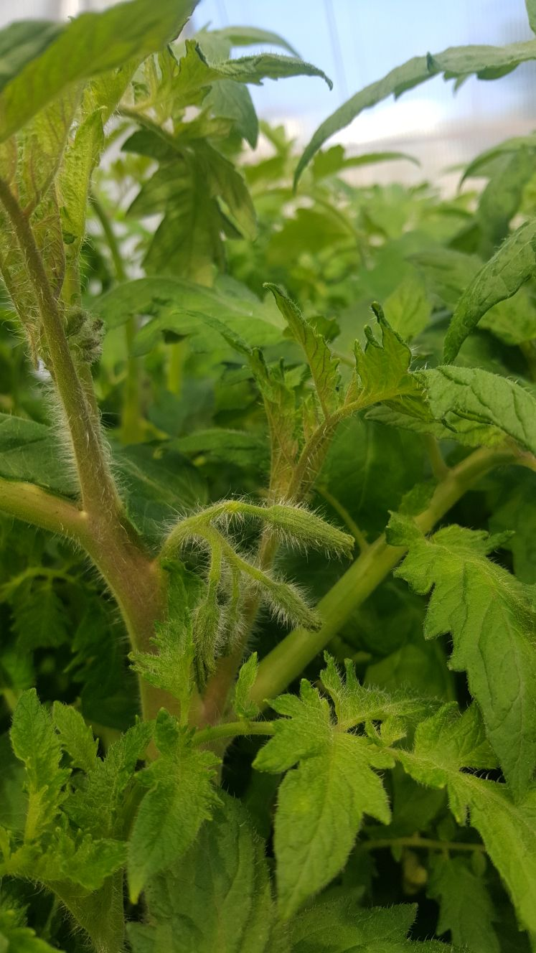
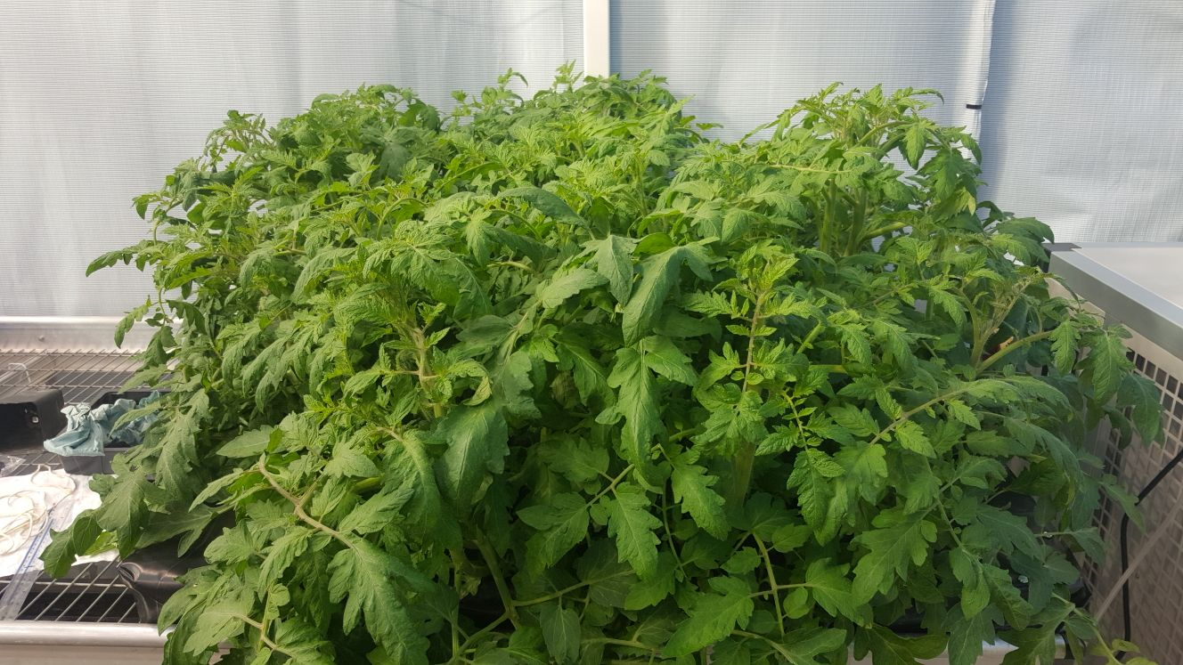

Slide 21
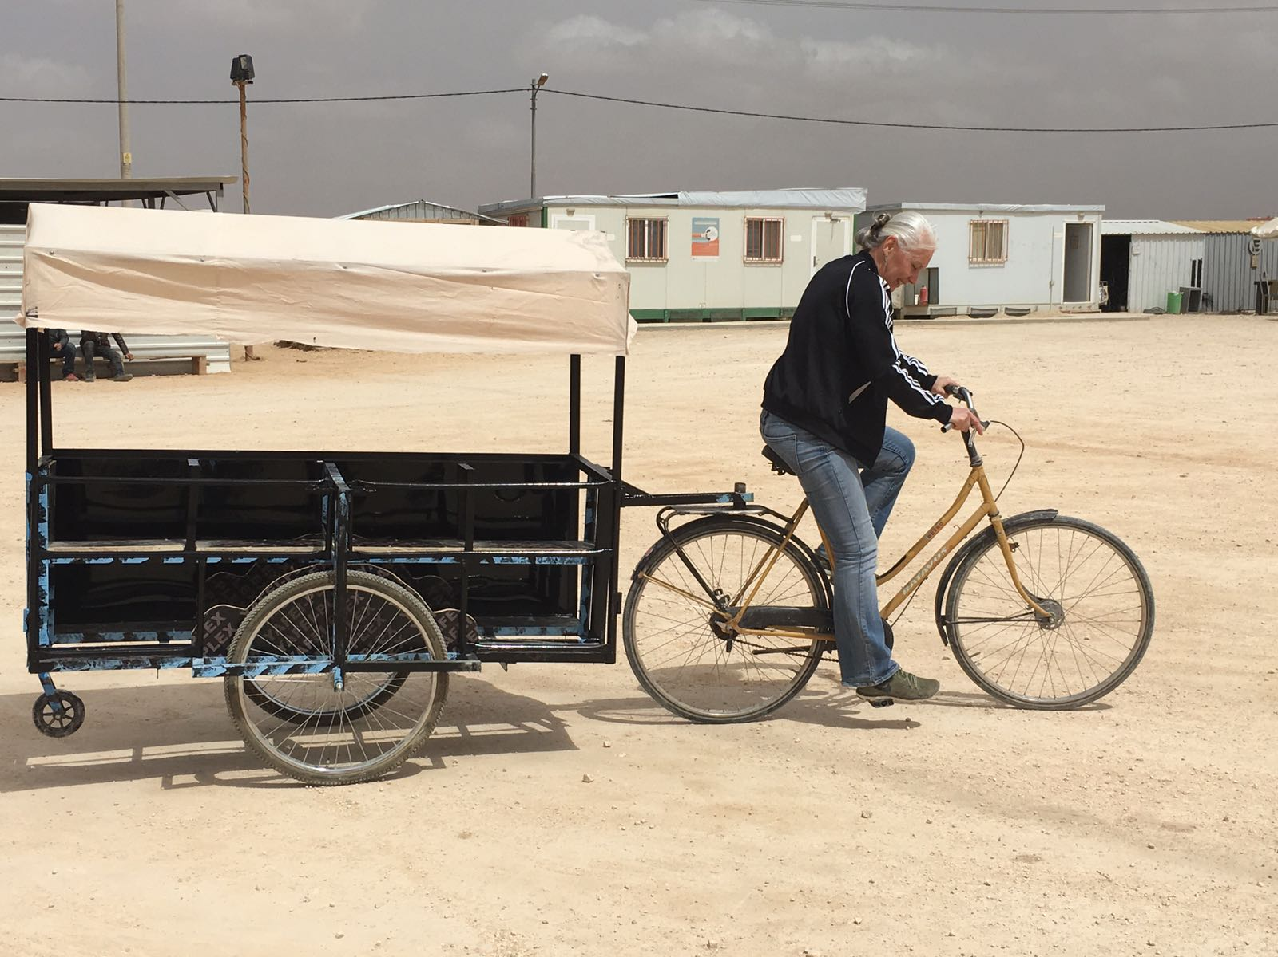

Slide 22
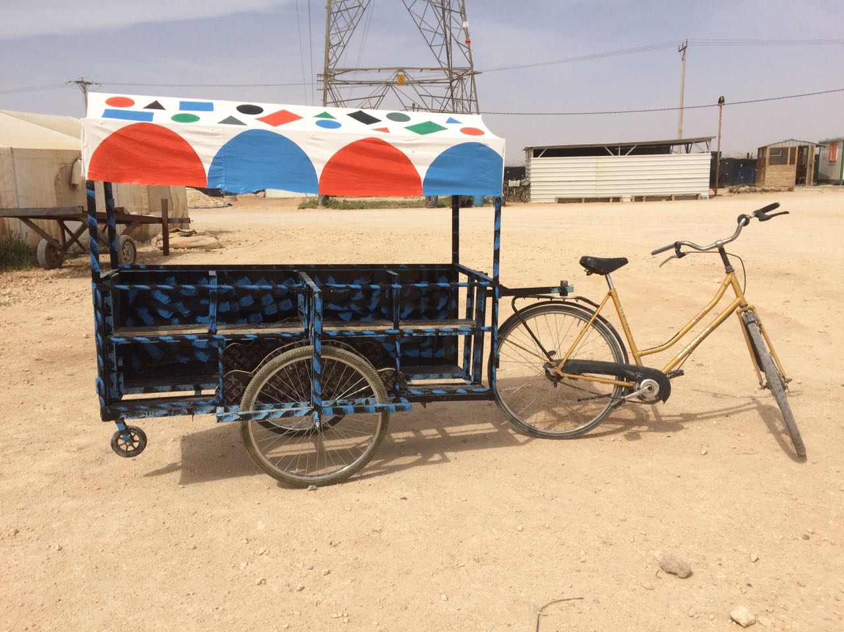

Slide 23
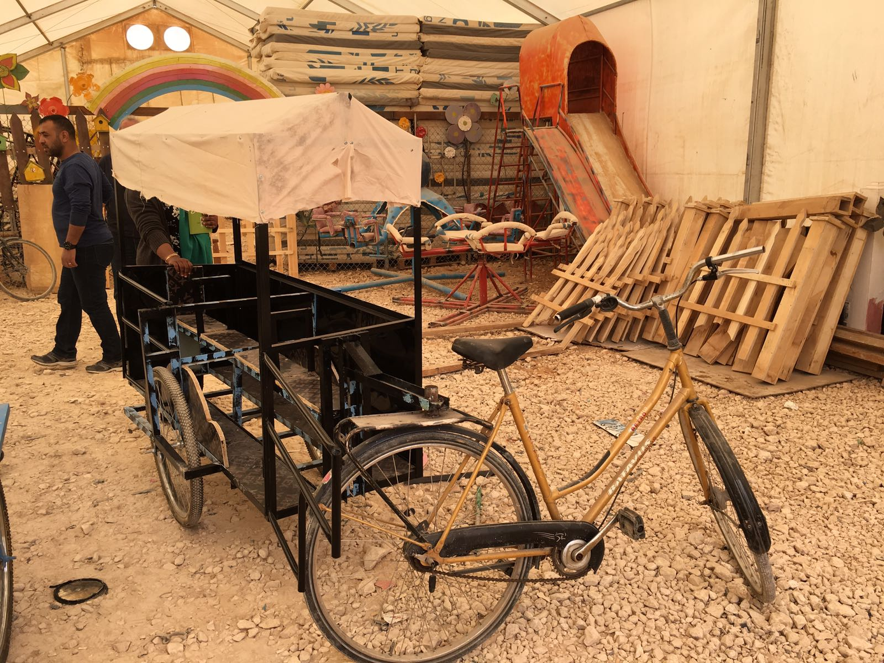

Slide 24
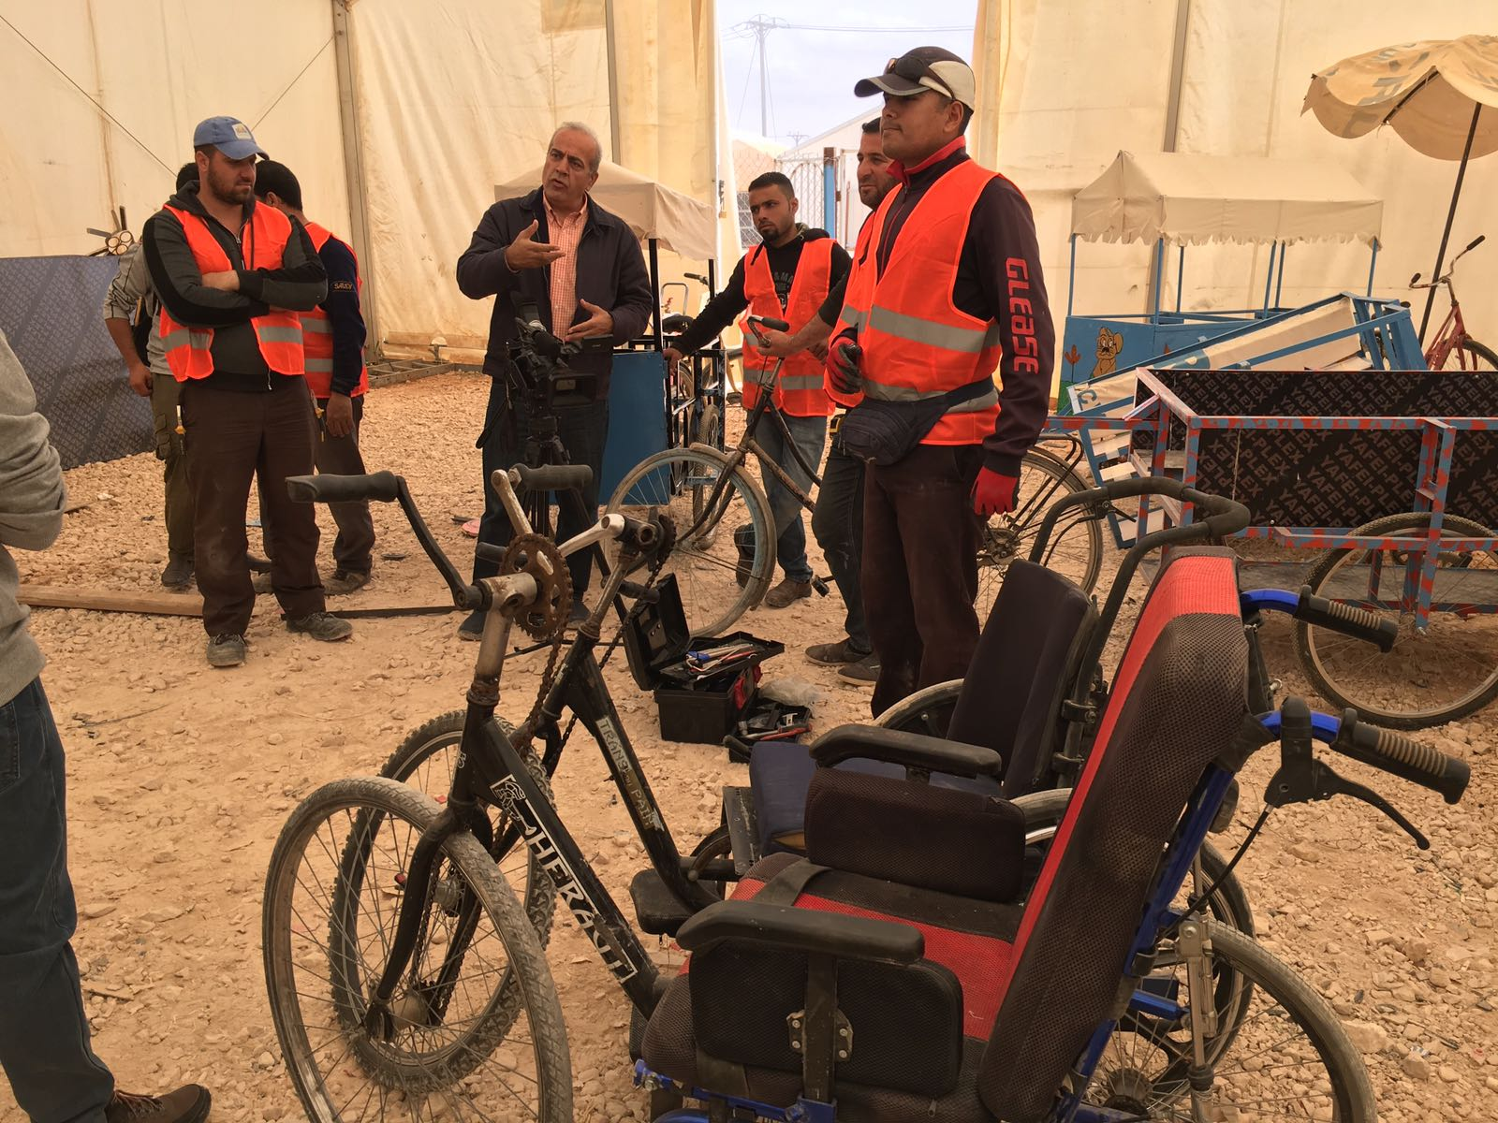

Slide 26
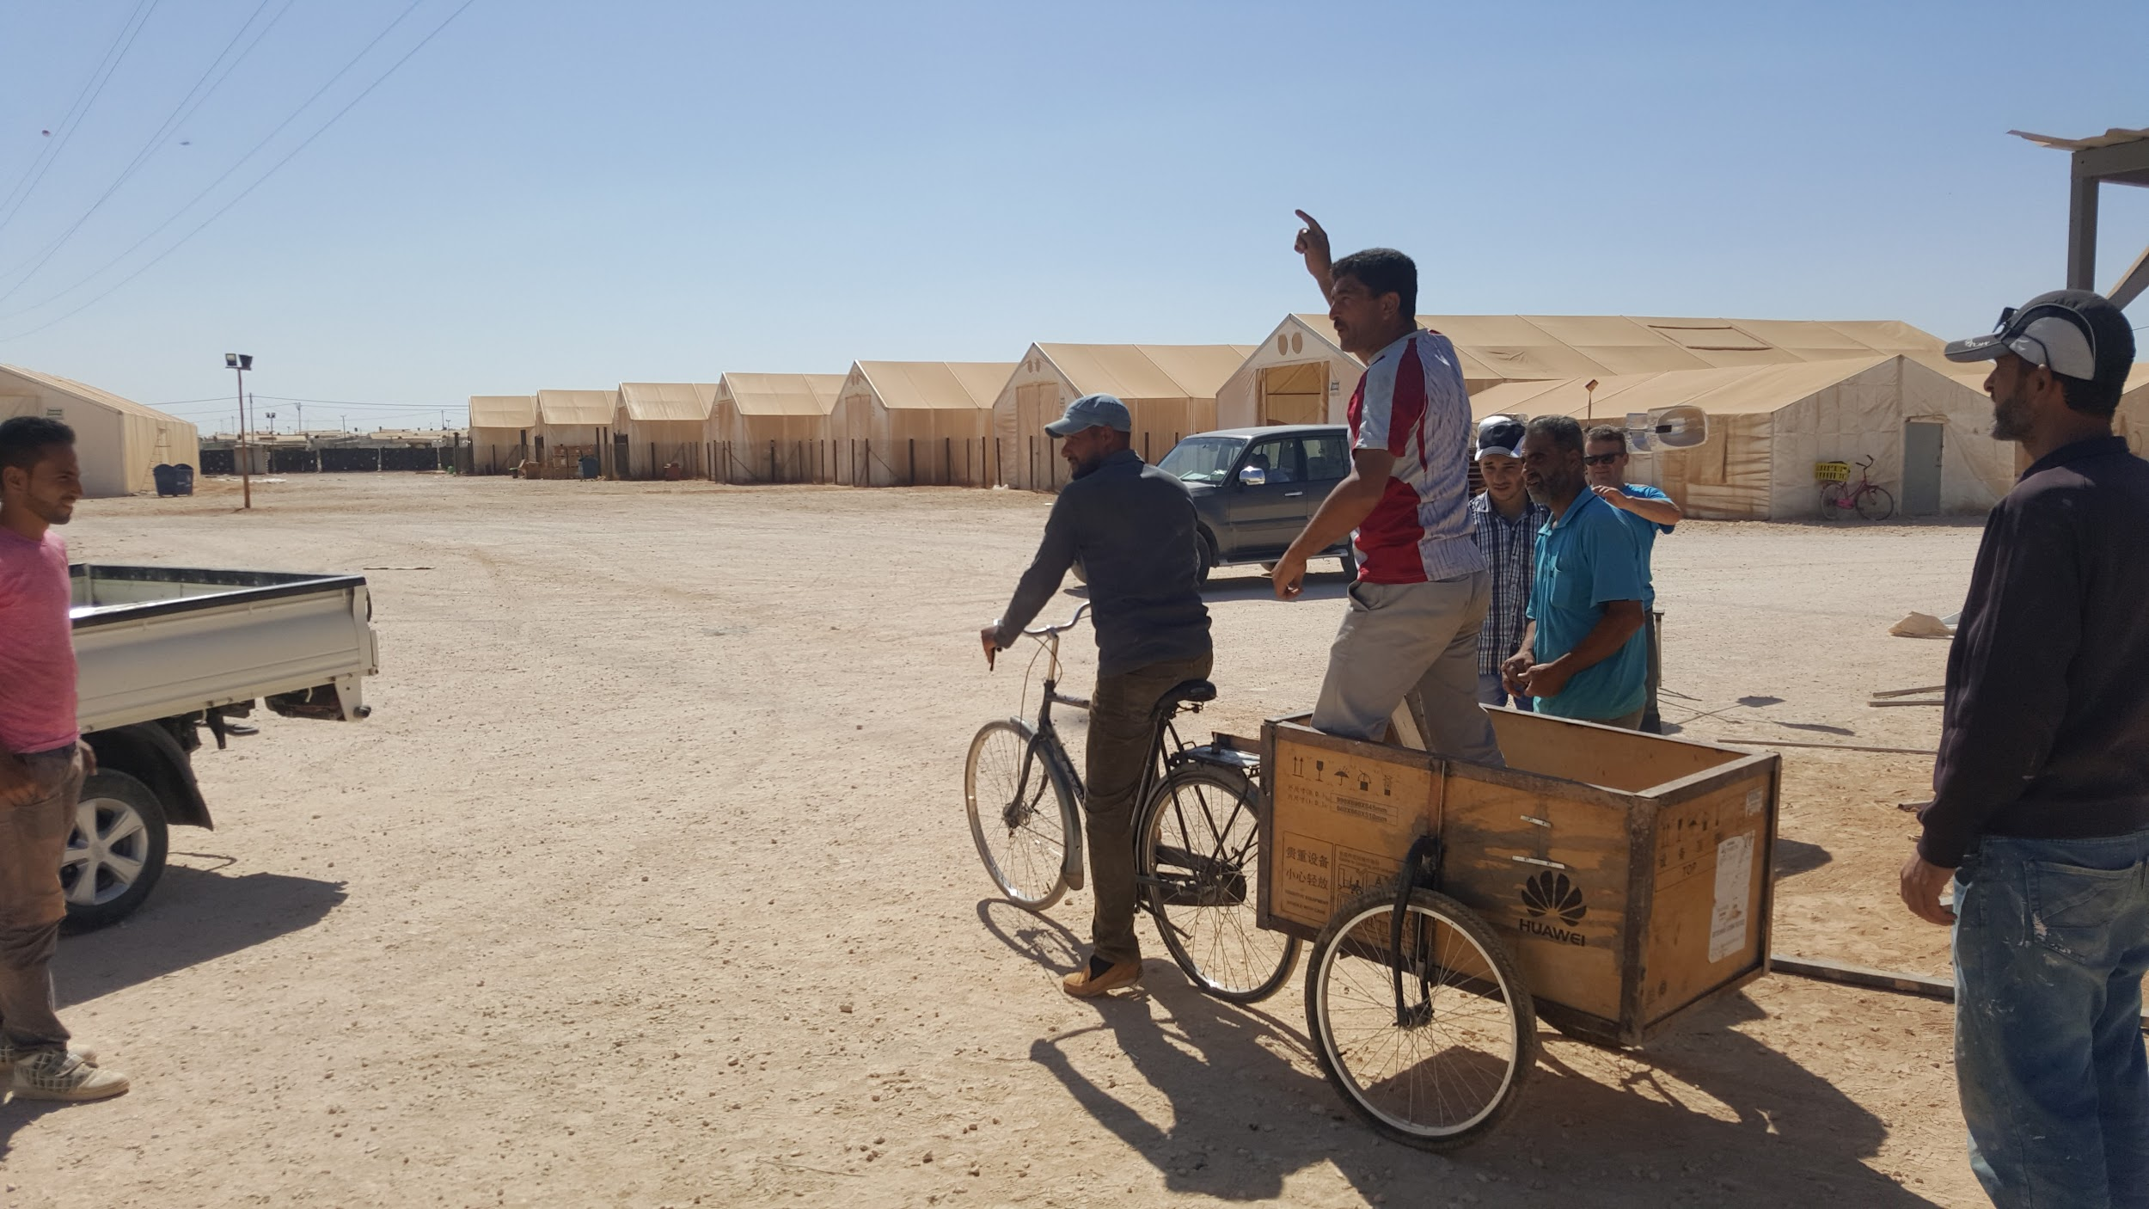
Onwards!

Slide 27
